Slide 1
The ABCs of Innovation
Innovation = Creativity + Commercialization

Slide 2
Outline
Innovation - What is it?
Types of innovation
Bill Ford on Innovation
What is Creativity?
Portrait of a Creative Person
Six Tips To Help You Enhance Your Creativity
… and another one: Find what you love to do
A Suggested Innovation Framework
Case Study: 3M – How do they manage innovation?
3M Innovation Strategy and Leadership

Slide 3
Innovation - What is it?
Innovation is the introduction of new ideas, goods, services, and practices which are intended to be useful (though a number of unsuccessful innovations can be found throughout history). The main driver for innovation is often the courage and energy to better the world. An essential element for innovation is its application in a commercially successful way. Innovation has punctuated and changed human history (consider the development of electricity, steam engines, motor vehicles, et al).
  en.wikipedia.org/wiki/Innovation

Slide 4
Bill Ford on Innovation
“..if we want to succeed as a company – and as an industry – we must drive innovation into everything we do: into technology, into safety, into design and into real-world solutions for environmental issues, like the impact of energy usage on our world.”
  Chairman Bill Ford's speech, NATIONAL PRESS CLUB WASHINGTON, DC November 22, 2005
“Innovation is going to be the compass by which this company sets its direction.” Bill Ford, Remarks On Innovation, Dearborn, Michigan, September 21, 2005

Slide 5
Types of innovation
In business and economics, innovation is often divided into five types:
Product innovation, which involves the introduction of a new good or service that is substantially improved. This might include improvements in functional characteristics, technical abilities, ease of use, or any other dimension.
Process innovation involves the implementation of a new or significantly improved production or delivery method.
Marketing innovation is the development of new marketing methods with improvement in product design or packaging, product promotion or pricing.
Organizational innovation (also referred to as social innovation) involves the creation of new organizations, business practices, ways of running organizations or new organizational behavior.
Business Model innovation involves changing the way business is done in terms of capturing value e.g. Compaq vs. Dell.
  Innovative Thinking: Six Simple Secrets by Padi Selwyn, M.A.

Slide 6
What is Creativity?
According to social psychologist Teresa Amabile, there are three basic ingredients to creativity:
Domain skills - Domain skills are developed as one becomes an expert in a field. To be a creative mechanical engineer, one must first master the fundamentals of the discipline.
Creative thinking skills - Creative thinking skills include seeking novelty and diversity, being independent, being persistent, and having high standards.
Intrinsic motivation - Intrinsic motivation implies that the reasons for doing things come from within - from passion and pleasure, not as a result of external demands, pressures, or rewards.
  Everyday Creativity: Principles for Innovative Design. Dr. Larry G. Richards

Slide 7
Portrait of a Creative Person
“Creative people pay attention to their world, see things differently, challenge assumptions, take risks, are not afraid to fail, and strive to generate multiple solutions to problems. They are passionate about creativity and seek opportunities to innovate.”
  Everyday Creativity: Principles for Innovative Design. Dr. Larry G. Richards

Slide 8
Six Tips To Help You Enhance Your Creativity
Open Your Mind - Have one new experience every day; no matter how small. New experiences stimulate the brain and help you make new and original connections; critical for boosting breakthroughs.
Diversify - Involve others in your problem-solving efforts who bring a different perspective or cultural experience than yours.
Mental Floss – Relax; Stress, exhaustion, boredom and even pain can block our pathways to creativity.
Stop Looking For the Right Answer - Look for many right answers.
Discover Your Creative Rhythm - Start paying attention to when you get your best ideas.
Health Makes Wealth - Regular exercise not only benefits your body, it boosts brain performance as well.
  Innovative Thinking: Six Simple Secrets by Padi Selwyn, M.A.
Notes:
Research has shown that regardless of age or education, everyone has the capacity to become more creative. Here are six tips to help you enhance your creativity and stimulate creativity with your co-workers.
1. Open Your Mind
Have one new experience every day; no matter how small. New experiences stimulate the brain and help you make new and original connections; critical for boosting breakthroughs. Attend new forms of entertainment, read books or magazines you’ve never read before, take a class in a subject you know nothing about, listen to music you profess to hate, go somewhere really different on your next vacation, talk to people you normally don’t have a chance to meet. New experiences become the raw material for new ideas. The cross-pollination of diverse ideas is a primary stimulator for creativity.
2. Diversify
Involve others in your problem-solving efforts who bring a different perspective or cultural experience than yours. In addition to picking the brains of experts and knowledgeable colleagues, talk to people who are unfamiliar about the issue. By using this approach, you’ll be asked “dumb questions” that can often help you question assumptions, and see your challenge from a different angle with fresh eyes and a more open mind.
A few years ago, I worked with a high-tech company to develop and implement a model for innovation that would solicit and reward creative contributions. The CEO assigned an established employee committee to work with me to create a model that fit their particular organizational culture.
It turned out that the committee was made up of the least educated, lowest paid employees in the company; many of whom did not speak English fluently. Yet the program that they designed was brilliantly innovative. Even the CEO was surprised when we presented the final design for his approval. After three years, the system developed by the least likely employees, continues to generate many creative contributions, company wide.
3. Mental Floss
Take time to clean out your “mental plaque” by flossing daily; unplugging and taking time out to relax. Studies have shown that our intelligence and creative problem-solving abilities nosedive about 25% when we’re stressed out. Stress, exhaustion, boredom and even pain can block our pathways to creativity.
Creativity often seeps in through the cracks. By allowing yourself time to quiet your mind each day, the solutions beneath the surface will bubble up and you’ll be available to catch them. Twenty minutes of uninterrupted incubation time daily will produce a plethora of ideas.
4. Stop Looking For the Right Answer
Look for many right answers. Multiple solution thinking can help you strengthen your creative muscle, while generating more ideas, which always leads to better ideas. Setting idea quotas can force you to push the envelope, forging past predictable, obvious solutions.
Thomas Edison died with 1,092 patents to his name as a result of setting quotas for himself and his staff. He quota was as follows: a minor invention every 10 days, a major one every six months.
In gold mining, it takes nearly 200,000 ounces of ore to produce just one ounce of gold. It’s no different with ideas. Mine with perseverance and patience, and you’ll be richly rewarded.
5. Discover Your Creative Rhythm
Everyone has creative performance peaks daily. Some of us get our best ideas during our morning commute, others wake up in the middle of the night with thunderbolts of genius. Unfortunately, most of us don’t honor this fertile idea-harvesting time. Start paying attention to when you get your best ideas. If you aren’t sure, keep a log for a week and jot down what time of day you are most mentally productive.
It’s been said that the difference between creative geniuses and “normal” people is that creatives have more effective capturing techniques. They pay attention to their best ideas and record them before they have a chance to slip away. Once you discover your creative rhythm, make sure you have a tape recorder, laptop, or pad and pencil nearby to capture your ideas.
6. Health Makes Wealth
A wealth of new ideas can be yours if you exercise regularly and eat well. Regular exercise not only benefits your body, it boosts brain performance as well.
One study found that 20-minute aerobic sessions twice weekly, kept up for eight weeks, brought about significant changes in creativity tests in college students who had not previously exercised. A well-oxygenated brain functions more effectively.

Slide 9
… and another one: Find what you love to do
“We know that people do their most creative work when they love doing what they’re doing. There’s no substitute for intrinsic motivation, that is, motivation that comes from within. Although such motivation doesn’t guarantee creativity, dislike or lack of interest in work practically guarantees non-creativity.”
  Ten Keys to Creative Innovation by Robert J. Sternberg, Ph.D. and Todd I. Lubart, Ph.D.

Slide 10
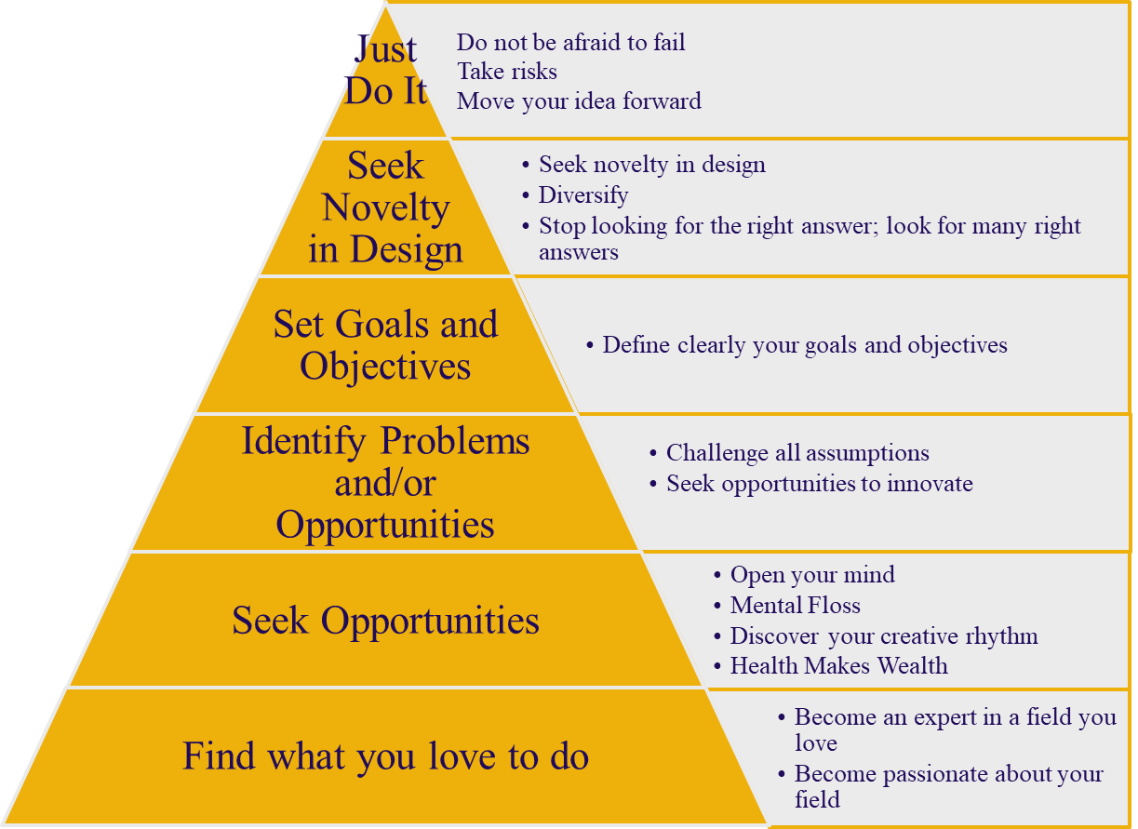
A Suggested Innovation Framework
Problem
and/or
Opportunity

Slide 11
Case Study: 3M – How do they manage innovation?
The company presents a consistent picture in interviews and in publications – innovation success is a consequence of creating the culture in which it can take place – it becomes ‘the way we do things around here’ in a very real sense. This philosophy is born out in many anecdotes and case histories – the key to their success has been to create the conditions in which innovation can arise from any one of a number of directions, including lucky accidents, and there is a deliberate attempt to avoid putting too much structure in place since this would constrain innovation.
  The 3M way to innovation: Balancing people and profit. New York, Kodansha International.

Slide 12
3M Innovation Strategy and Leadership
Setting stretch targets – such as ‘x% of sales from products introduced during the past y years’ – provides a clear and consistent message and a focus for the whole organization.
Allocating resources as ‘slack’ – space and time in which staff can explore and play with ideas, build on chance events or combinations, etc.
Encouragement of ‘bootlegging’ employees working on innovation projects in their own time and often accessing resources in a non-formal way – the ‘benevolent blind eye’ effect.
Provision of staged resource support for innovators who want to take an idea forward – effectively different levels of internal venture capital for which people can bid (against increasingly high hurdles) – this encourages ‘intrapreneurship’ (internal entrepreneurial behavior) rather than people feeling they have to leave the firm to take their good ideas forward.

Slide 13
Exercises and Discussion

